Slide 1


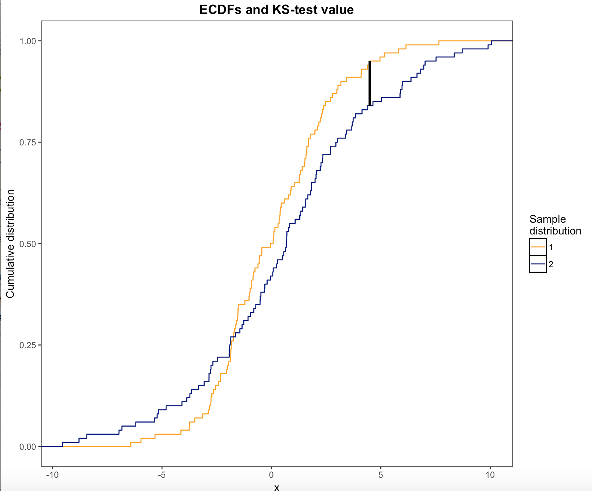
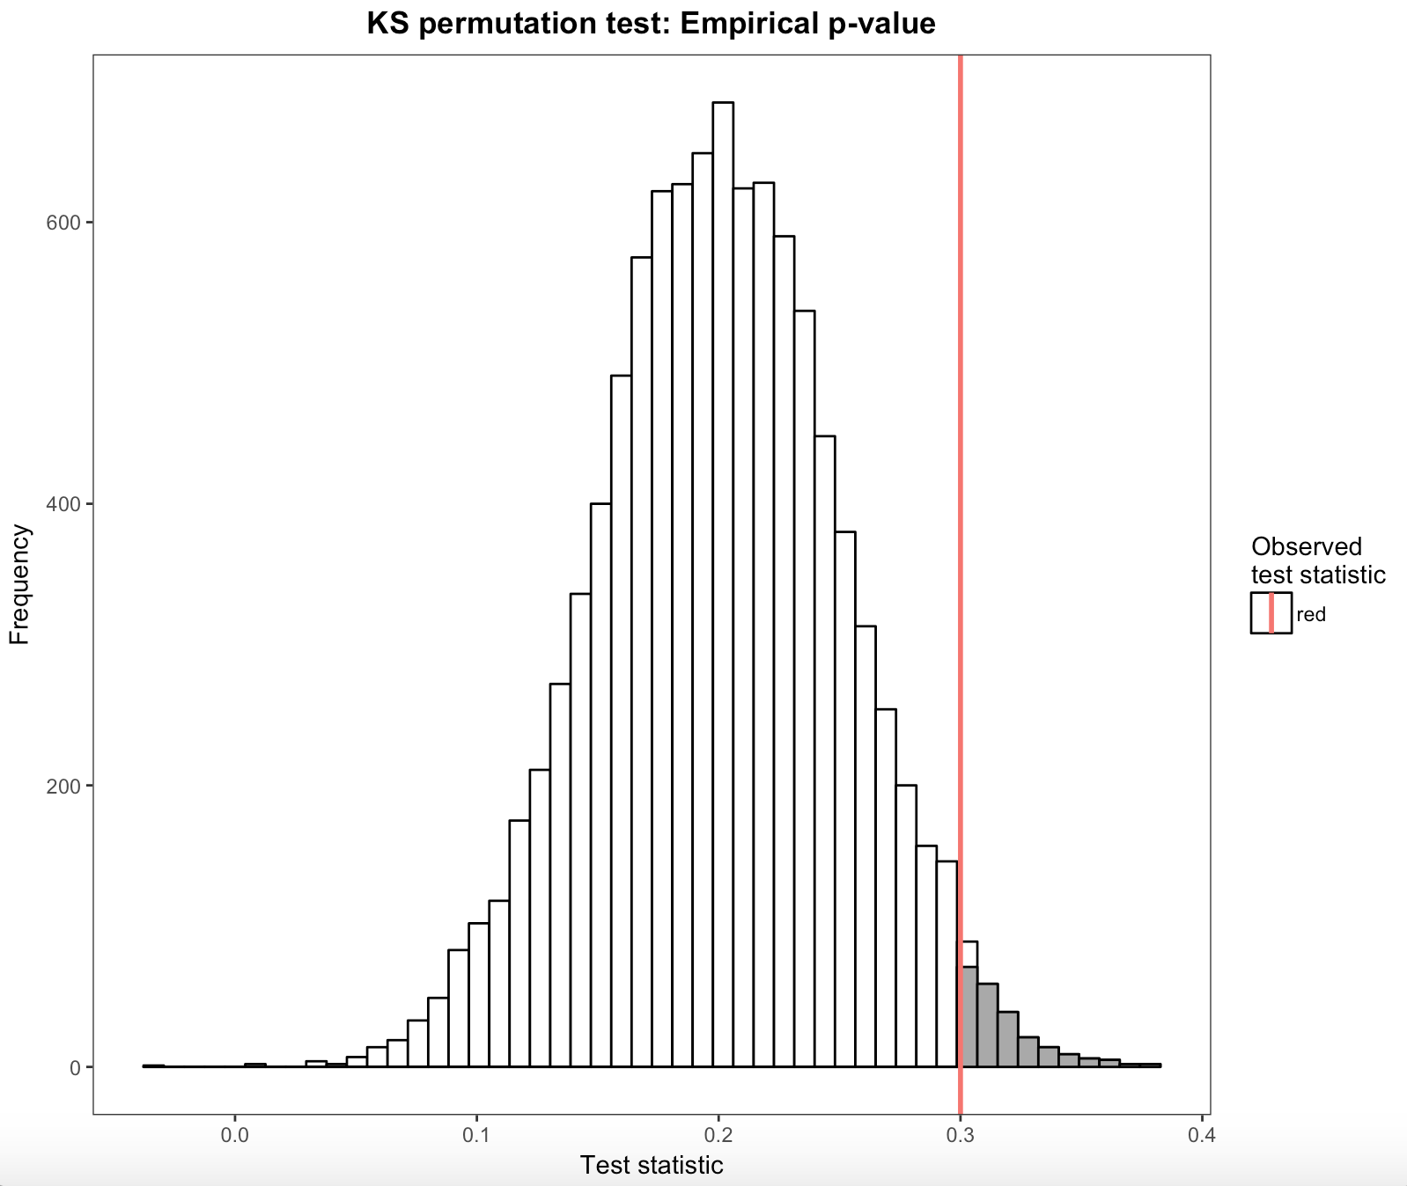

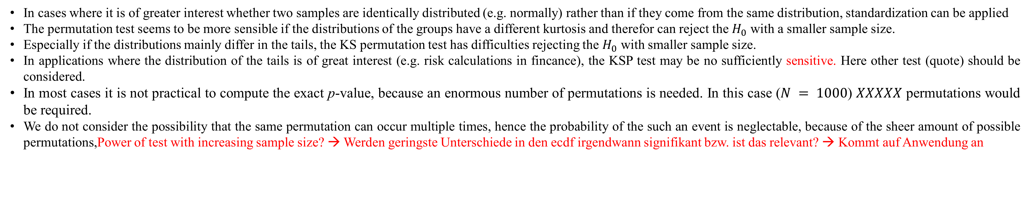


Some Monte Carlo topic
Munch, J., Meyer-Grant, C., Höft, N.
Statistics M. Sc. - Joint masters program
Free University Berlin, Berlin, Germany
Humboldt University Berlin, Berlin, Germany
1. Theory
2. Methods
Permutation tests are nonparametric resampling-based tests, where samples are drawn without replacement unlike in bootstrapping (Rizzo, 2008)
One of various applications (see Good, 2000) is the Kolmogorov-Smirnoff permutation test (KSP test)
Since many statistical methods require assumptions about the distibutions that the sample was drawn from, the Kolmogorov-Smirnoff test (KS test) can be used to test the sample distribution against a theoretical distribution
When two emprical distibutions are tested against each other, the KS test becomes invalid since the distribution under $H_{0}$ is no longer a KS distribution but unknown (Praestgaard, 1995)
This problem can be overcome by using the KSP test of the hypothesis $H_{0}:F=G$ vs $H_1 :F≠G$
Under $H_{0}:F$ and $G$ are both samples from the same distribution
The test creates random permutations of the samples
The resulting distribution of the KS test statistic is used to compute an empirical p-value
This p-value is exact when all $\frac{N!}{n!×m!}$ permutations are considered, otherwise a subset of $k$ permutations can be used to approximate this p-value
$N = 1000$ random samples were drawn from a standard normal distribution and split up into two equally large groups
The observed KS test statistic is the maximal distance between the emprirical cumulative distribution functions
Number of permutations ($k$) from $10$ to 1000 in steps of $10$
The calculation of the empirical p-value (fraction of test statistics that exceeded the originally observed test statistic) for each value of k was repeated XXX times
Means and the variances of the empirical p-values were computed
Since these p-values are i.i.d., by central limit theorem, normality can be assumed for the calculation of confidence intervals
Consecutively we simulated the permutation test for different sample sizes ranging from 10 to 5000 observations. We used 400 permutations and repeated the test 400 times for each sample size. Each sample was divided into two groups, were one group was drawn from a normal distribution and the other group from four different distributions (normal, t, chi-sq. and uniform dist.) with the same means and variances.
3. Results
Figure 1. ECDFs and KS test statistic
Figure 2. Histogram of simulated KS test statistics and empirical 95% quantile
Figure 3. Density estimation for the empirical p-values for four different number of permutations
Figure 4. Mean and 95%-CI of empirical p-values for different numbers of permutations
As the number of permutations increases the computed p-value approaches the exact value in a given sample (grafik).
This is shown under $H_{0}$ (grafik) since there are no systematic variance minimizing influences on the p-value other than the number of permutations.
Under $H_{1}$ the size and location of the test-statistic (maximum deviation of the ecdfs) depend on the underlying distributions, while under $H_{0}$ they are random.
As the sample size increases the test statistic approaches the maximal deviation between the corresponding theoretical distributions.
Under $H_{0}$ the sample size $N$ has no impact on the accuracy of the p-value. The realizations will in 95% of all cases have a p-value between 2.5% and 97.5% regardless of the sample size since both subsamples are drawn from the same distribution. So the initial test statistic has no systematic bias which could become more pronounced by an enlarged sample size.
However, und the $H_{1}$ the sample size $N$ actually has a big effect. With an increasing sample size the empirical distribution functions become more similar to the theoretical distribution functions. So therefore it requires a larger $N$ if the distributions are assumed to be similar.
Since the initial theoretical distribution functions are different under $H_{1}$ and the permutations constructs two subsamples which are drawn from the same theoretical distribution, a higher $N$ yields more consistent p-values.
Discussion
In cases where it is of greater interest whether two samples are identically distributed (e.g. normally) rather than if they come from the same distribution, standardization can be applied
The permutation test seems to be more sensible if the distributions of the groups have a different kurtosis and therefor can reject the $H_{0}$ with a smaller sample size.
Especially if the distributions mainly differ in the tails, the KS permutation test has difficulties rejecting the $H_{0}$ with smaller sample size.
In applications where the distribution of the tails is of great interest (e.g. risk calculations in fincance), the KSP test may be no sufficiently sensitive. Here other test (quote) should be considered.
In most cases it is not practical to compute the exact p-value, because an enormous number of permutations is needed. In this case ($N = 1000$) $XXXXX$ permutations would be required.
We do not consider the possibility that the same permutation can occur multiple times, hence the probability of the such an event is neglectable, because of the sheer amount of possible permutations,Power of test with increasing sample size? → Werden geringste Unterschiede in den ecdf irgendwann signifikant bzw. ist das relevant? → Kommt auf Anwendung an
References:

